Slide 1
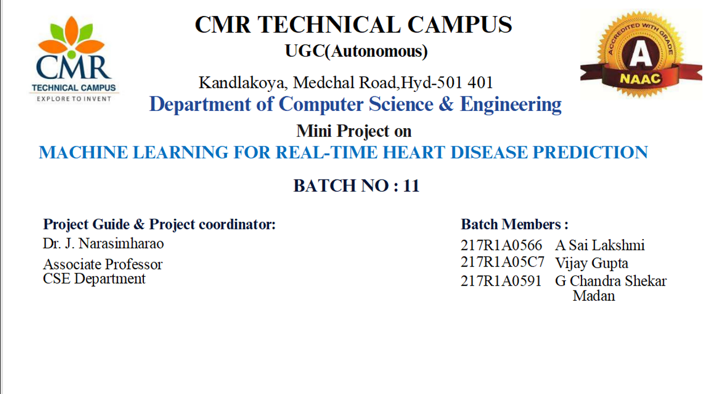

Major Project on
Courier Management System
Project Coordinator
Dr. J. Narasimharao
Associate Professor
Project Guide
R. Sai Krishna
Assisstant Professor
BATCH NO: 23
Batch Members
217R1A0597 K.Vamshi
217R1A05B7 R.Akhila
217R1A0580 B. Sai Charan

Slide 2

TABLE OF CONTENTS
Abstract
Existing Systems
Proposed Systems
Advantages
Hardware and Software Requirements
Novality of Project
Architecture
Modules
UML diagrams
Sample code
Results
Conclusion
Future Scope
References

Slide 3

ABSTRACT
The Courier Management System is a comprehensive platform designed tostreamline and optimize the management of courier and logistics operations. This system facilitates efficient handling of tasks such as parcel booking, tracking, delivery scheduling, and route optimization. It caters to both end-users and administrators, ensuring smooth communication and operational transparency. Key features include real-time tracking of parcels, automated calculation of shipping charges, and an intuitive interface for booking and managing deliveries.

Slide 4
EXISTING SYSTEMS
The current systems are characterized by manual processes and disjointed operations. Courier companies often use paper-based tracking methods and non integrated booking and dispatch systems. This lack of automation and system cohesionmakes delivery planning inefficient and error-prone. Additionally, customers cannot accurately track the status of their parcels, leading to dissatisfaction and mistrust.

Slide 5
PROPOSED SYSTEMS
The proposed Courier Management System (CMS) introduces a fully automated, comprehensive, and customer-centric solution. It offers a user friendly interface accessible via web and mobile platforms for booking services, real-time parcel tracking, and feedback submission. Advanced routing and dispatching algorithms optimize delivery routes based on real-time data, ensuring cost-efficient and timely parcel delivery. Robust reporting and analytics provide courier companies with actionable insights to improve their operations and enhance customer satisfaction.

Slide 6
ADVANTAGES
Automation of key processes, such as parcel booking, dispatching, and routing, significantly improves efficiency.
Enhanced customer experience through real-time tracking, transparency, and easy feedback mechanism
Optimized resource allocation and delivery routes reduce operational costs and delivery times.

Slide 7


HARDWARE REQUIREMENTS
Processor : i3 core (or) more
RAM : 4 GB (minimum)
Hard Disk : 20 GB
Keyboard : Standard Windows Keyboard
Monitor : SVGA

Slide 8
SOFTWARE REQUIREMENTS
Operating System : Windows 7 Ultimate (or) more
Coding Language : Python
Front-End : Python
Back-End : Django
Designing : HTML, CSS, JavaScript
Database : MySQL (WAMP Server)

Slide 9

NOVELTY OF PROJECT
The Courier Management System is a comprehensive platform designed to streamline and optimize the management of courier and logistics operations. This system facilitates efficient handling of tasks such as parcel booking, tracking, delivery scheduling, and route optimization. It caters to both end-users and administrators, ensuring smooth communication and operational transparency. Key features include real-time tracking of parcels, automated calculation of shipping charges, and an intuitive interface for booking and managing deliveries.

Slide 10
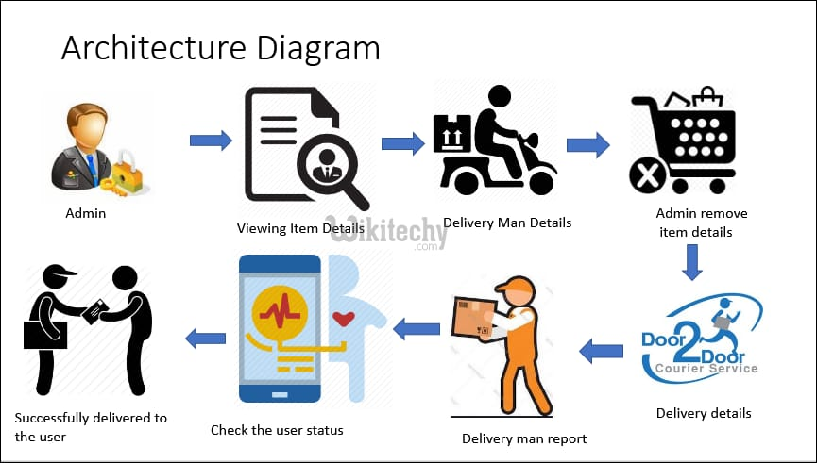
ARCHITECTURE

Slide 11
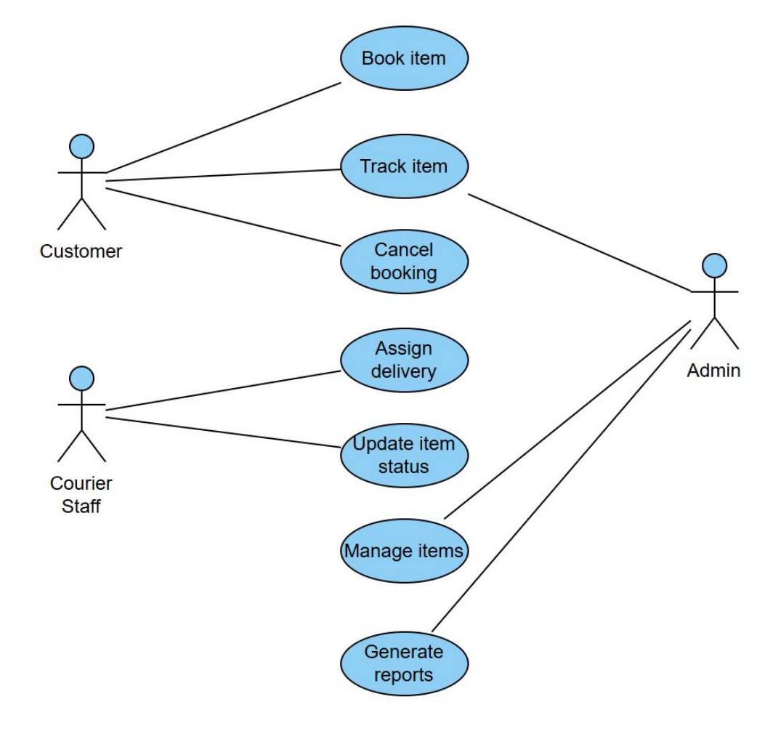
UML DIAGRAMS
USE CASE DIAGRAM

Slide 12
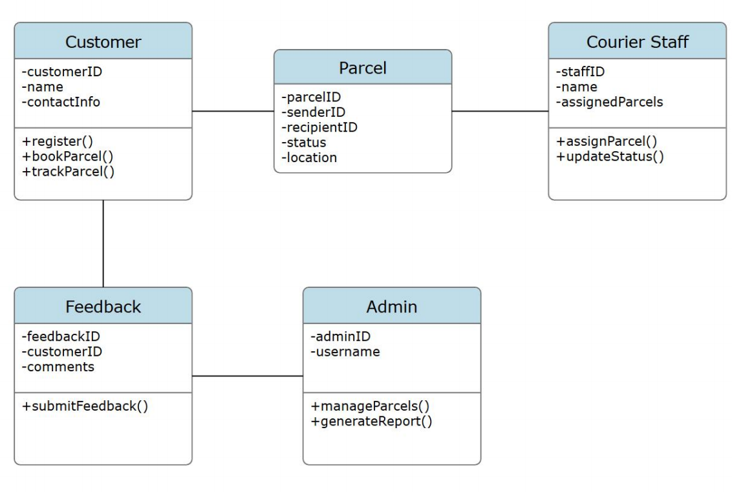
CLASS DIAGRAM
1
1
1..*
1
1
1
1

Slide 13
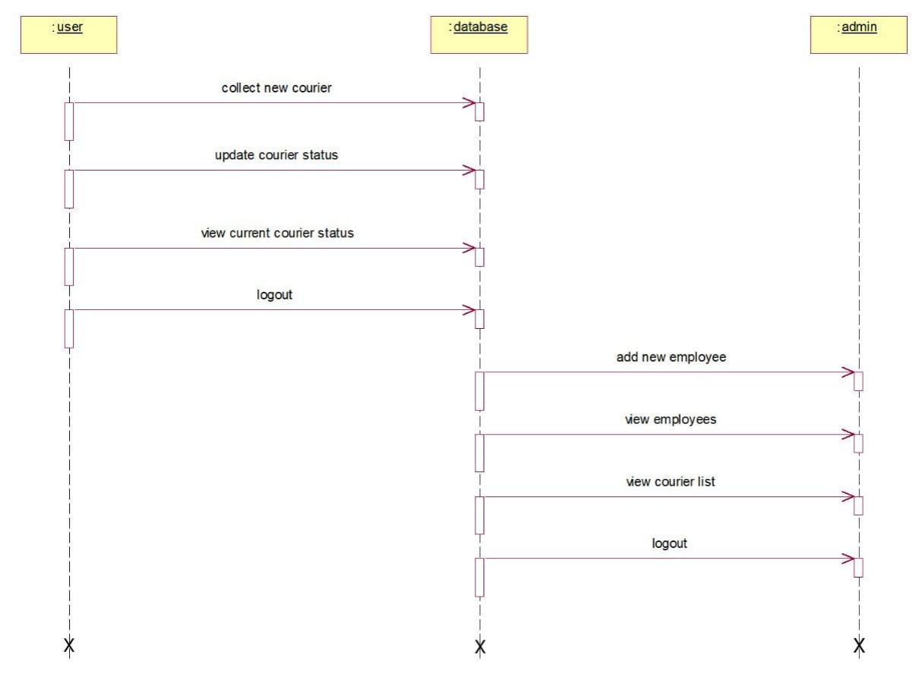
SEQUENCE DIAGRAM

Slide 14
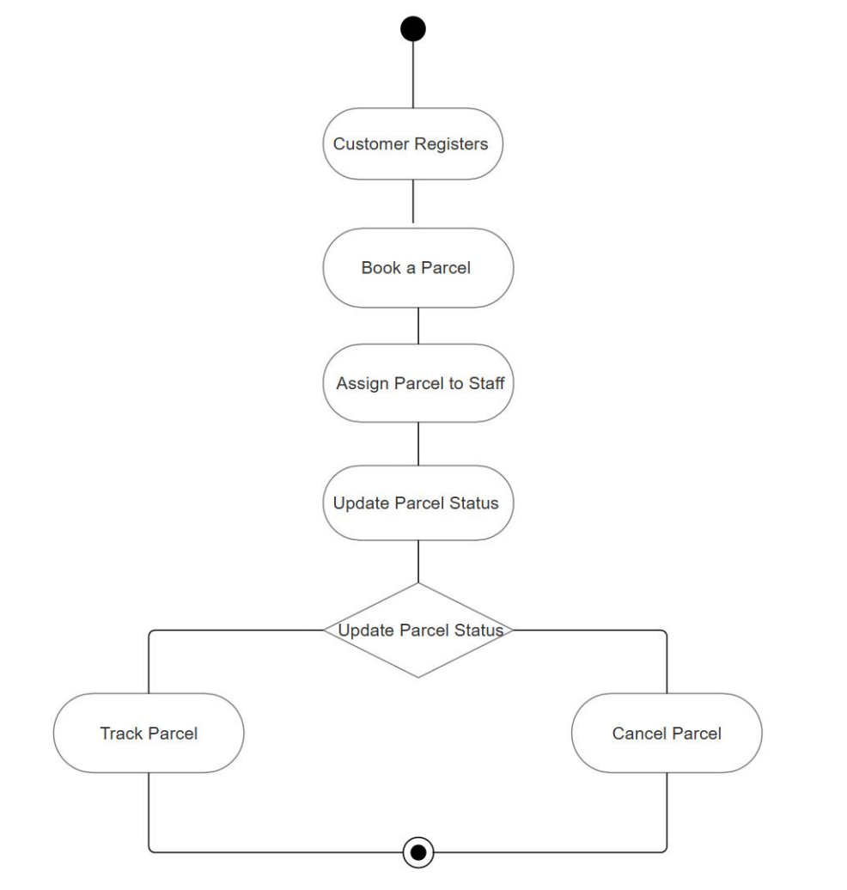
ACTIVITY DIAGRAM

Slide 15


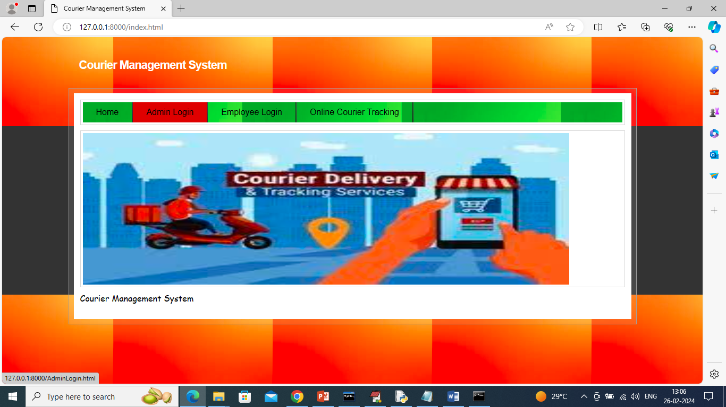
PROJECT EXECUTION
USER REGISTRATION

Slide 16
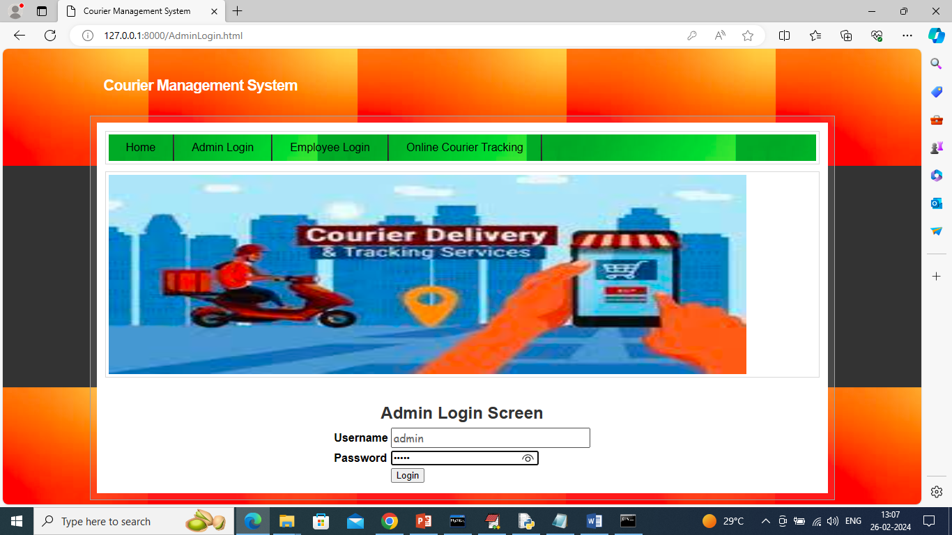
USER PREDICTING ATTACK TYPE

Slide 17

USER PROFILE

Slide 18
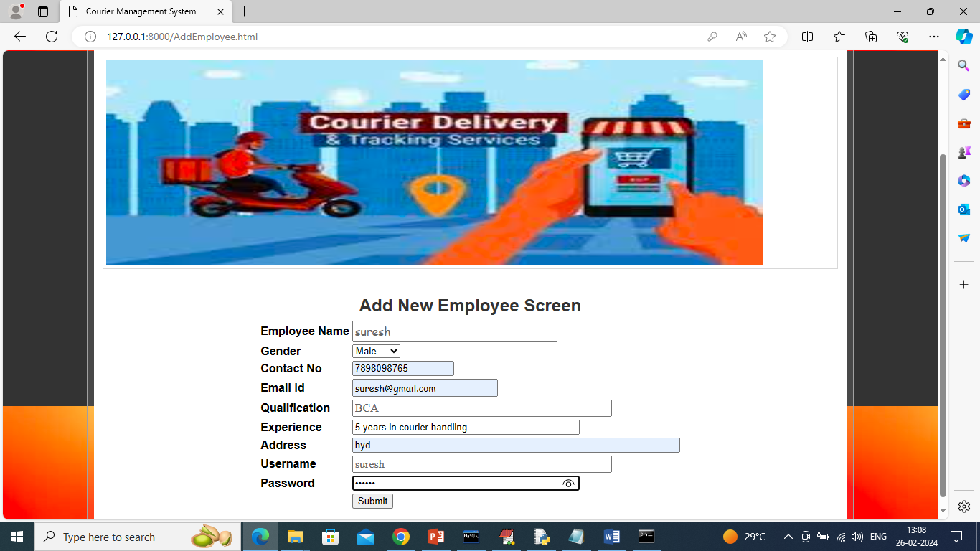
SERVICE PROVIDER LOGIN

Slide 19
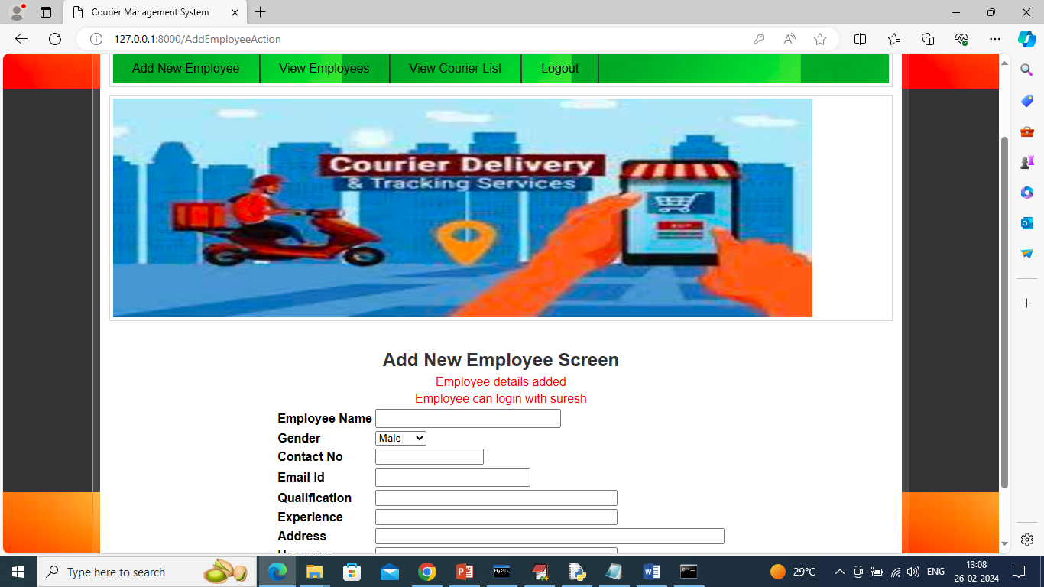
SERVICE PROVIDER HOME PAGE

Slide 20
REPRESENTATION OF TRAINED AND TESTED DATASET RESULTS IN BAR GRAPGH

Slide 21

REPRESENTATION OF TRAINED AND TESTED DATASET RESULTS IN LINE CHART

Slide 22

REPRESENTATION OF TRAINED AND TESTED DATASET RESULTS IN PIE CHART

Slide 23
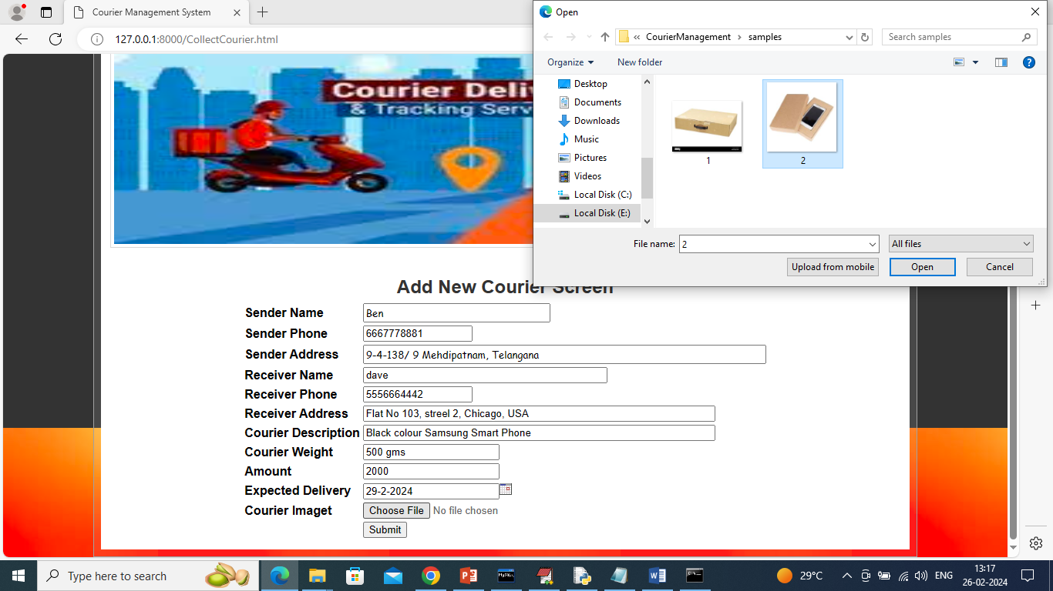
PREDICTION OF CYBER ATTACK TYPE

Slide 24
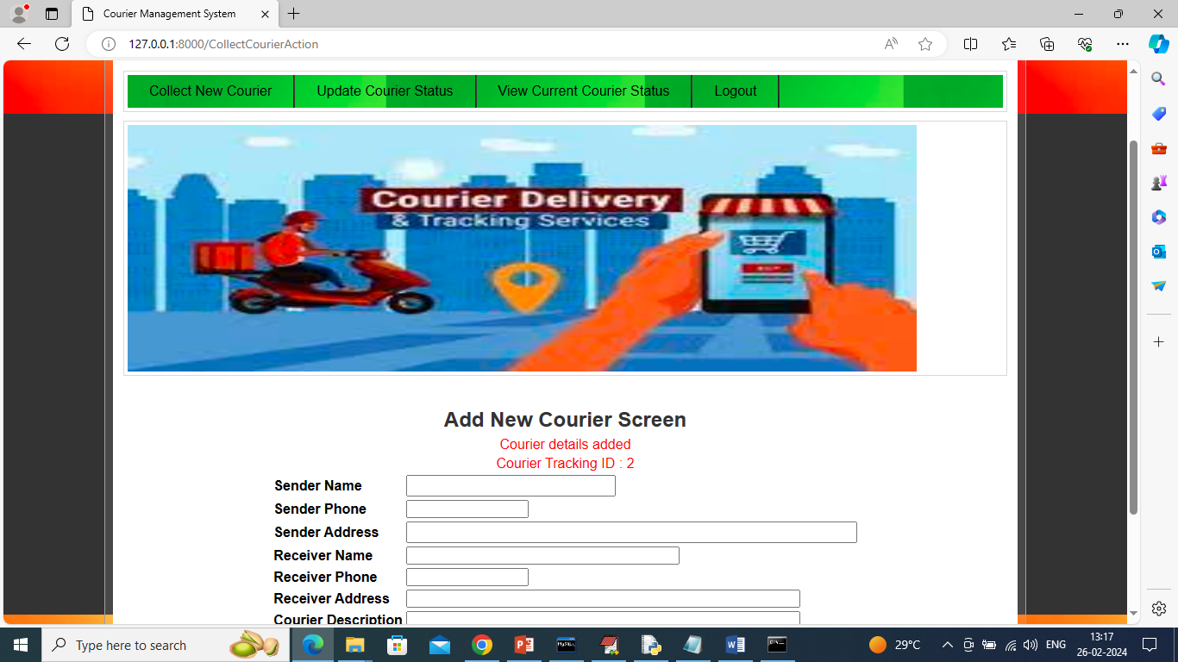
PREDICTION OF CYBER ATTACK TYPE RATIO

Slide 25
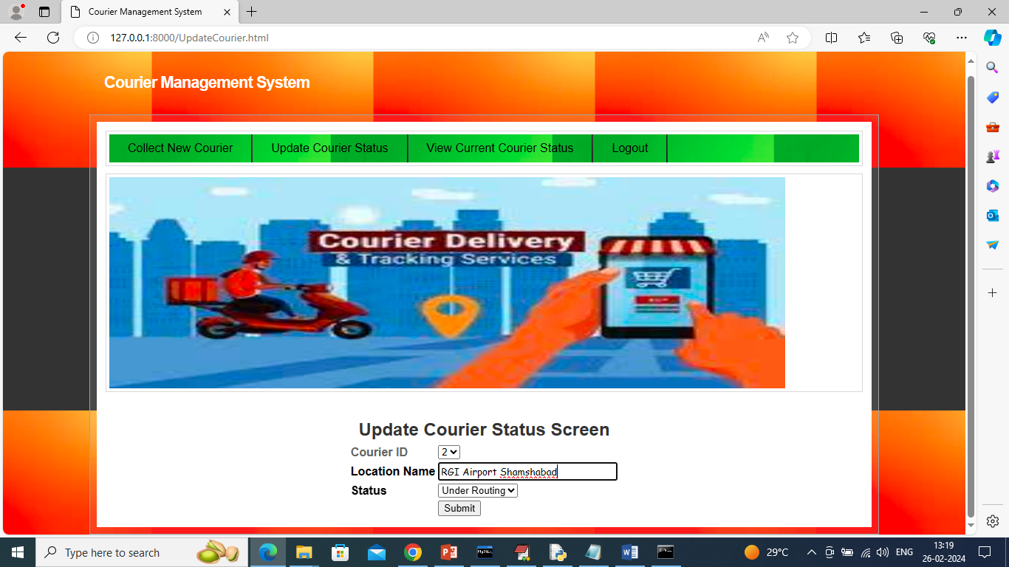
REPRESENTATION OF CYBER ATTACK TYPE RATIO IN LINE CHART

Slide 26
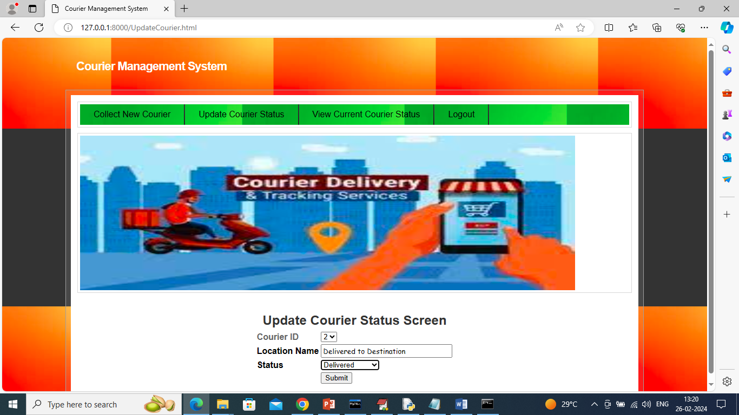
REPRESENTATION OF CYBER ATTACK TYPE RATIO IN PIE CHART

Slide 27
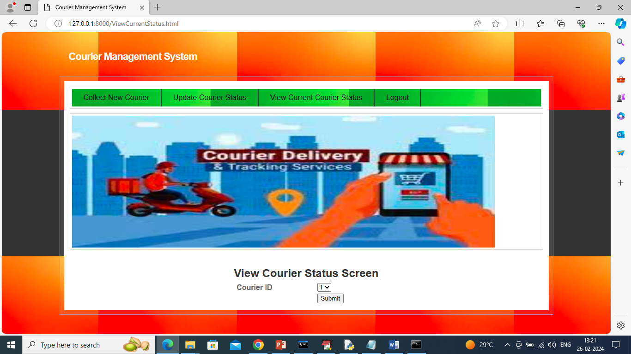
REMOTE USERS DATA

Slide 28
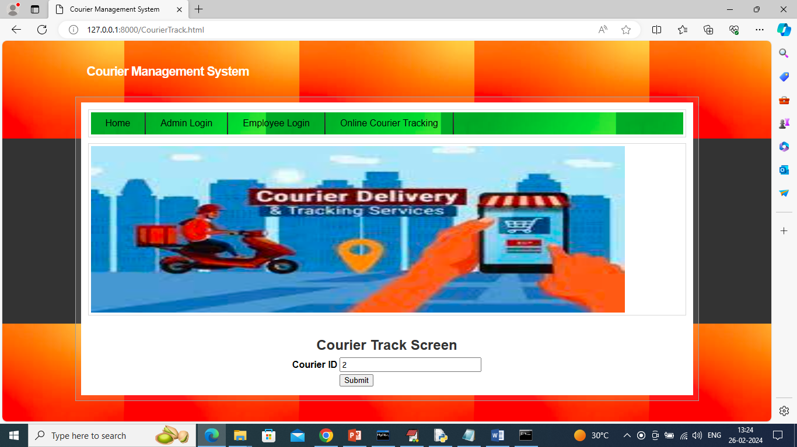

Slide 29
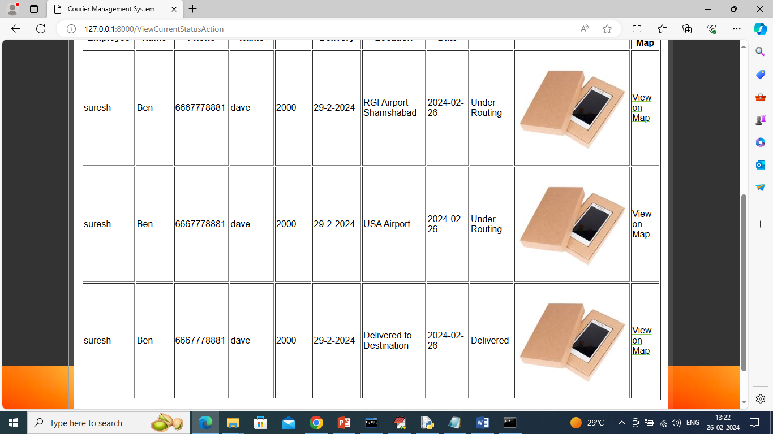
PREDICTED DATASET RESULTS

Slide 30
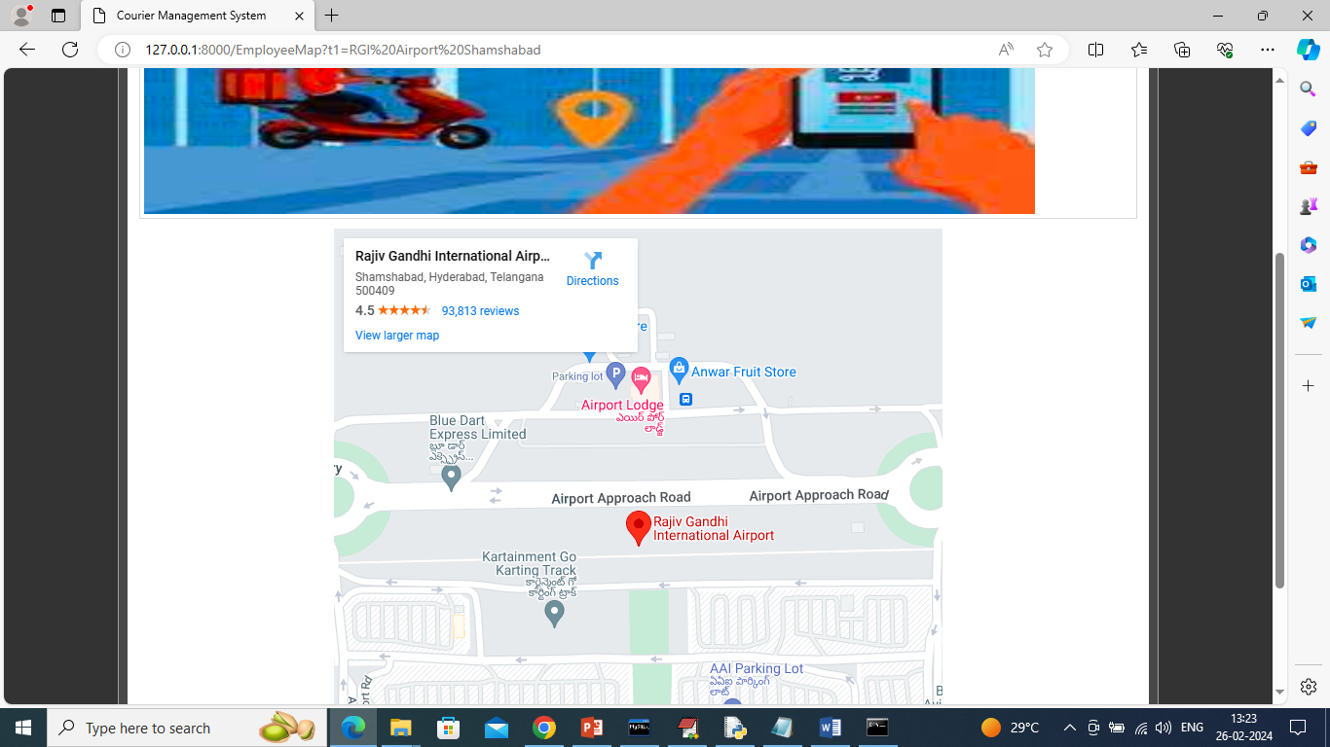

Slide 31


CONCLUSION
In conclusion, this study underscores the crucial role of AI in enhancing cybersecurity in smart cities, with e-Governance acting as a vital mediator. The involvement of various stakeholders significantly strengthens the AI-e-Governance-cybersecurity relationship. By addressing challenges like data complexity and funding gaps, smart cities can improve resilience against cyber threats. This research offers practical insights for governments to bolster cybersecurity measures through AI and collaborative governance.

Slide 32
FUTURE SCOPE
Real-time Tracking & AI-based Route Optimization – Improve delivery efficiency using GPS and AI-driven route suggestions.
Cloud & Scalability – Host on AWS/GCP for multi-user access and high availability.
IoT & Automation – Use RFID, smart warehousing, and drone-based deliveries for faster operations.
Security & Blockchain – Ensure data security with encryption, MFA, and blockchain for transparent tracking.
Mobile App & E-commerce Integration – Develop mobile apps, AI chatbots, and integrate payment/e-commerce APIs.

Slide 33
MODULES
Service Provider Module :
Login: Access the system securely.
Manage Datasets: Browse, train, test, and download datasets.
View Accuracy and Results: Check accuracy in bar charts and detailed metrics.
Item tracking: Tracking the location of item.
User Management: View all remote users.
Admin Module :
View and Authorize Users: Manage user registrations and authorizations.
Remote User Module :
Register and Login: Create and access accounts.
View Profile: Access personal account details.

Slide 34
REFERENCES
"Design and Implementation of an Intelligent Courier Management System" Shahid, N., Khalid, A., Usama, M. (2021). IEEE Access.
"A Review of Logistics and Courier Management Systems: Trends and Technologies"
Gupta, R., Verma, P. (2020). Journal of Logistics Management.
"Enhancing Courier Services with Real-Time Tracking and Route Optimization"
Smith, J., Brown, L. (2019). International Journal of Supply Chain Management.
"Customer Satisfaction in Courier Management Systems: A Case Study Approach"
Johnson, A., Williams, M. (2021). Journal of Business Research.

Slide 35
Thank you

